Slide 1
APUSH Review: Manifest Destiny
Everything You Need To Know About Manifest Destiny To Succeed In APUSH

Slide 2
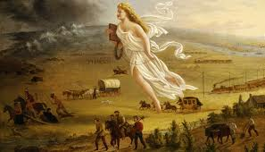
Manifest Destiny: An Intro
What is it?
Belief that it was America’s “God-Given” right to expand from coast to coast
Term that was created by John O’Sullivan
When time period is associated with it?
1840s and 1850s
Although it has roots in the LA Purchase and Indian Removal Act
Key Associations:
Oregon
Texas
Mexican-American War

Slide 3
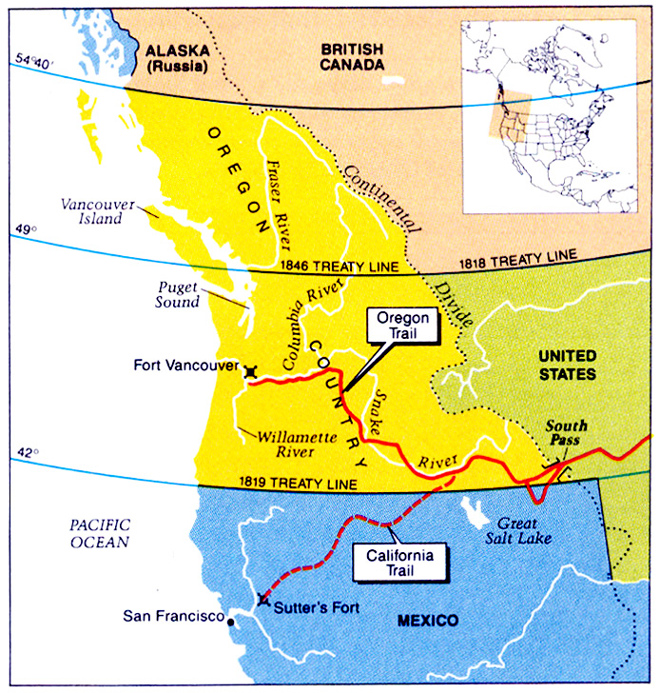
Oregon
At one time, four countries claimed Oregon:
Spain
Britain
Russia
US
The boundary was not settled between US and Great Britain
Polk campaigned on “54°40’ or Fight”
Eventually, the two sides settle on the 49th parallel

Slide 4
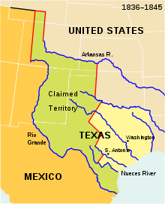
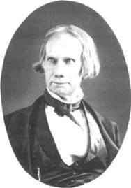
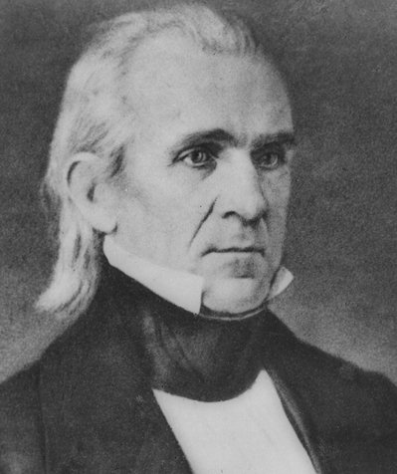
Texas
I flip-flopped on the annexation of Texas
In 1836, Texas declared independence from Mexico
1844 presidential campaign focused on the issue of Texas
In 1845, Texas is annexed via a joint resolution
Southerners favored the admission as a way to expand slavery
The boundary was not settled by both US and Mexico
Helps lead to the…….
I advocated the annexation of Texas…

Slide 5
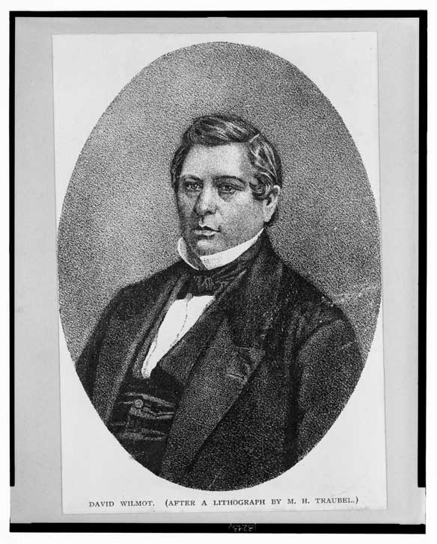
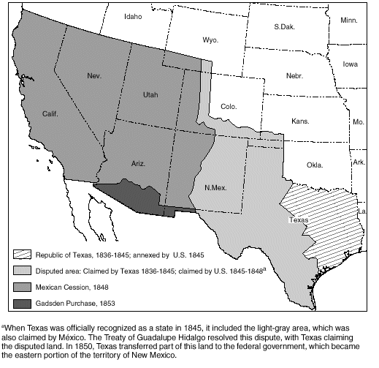
Mexican-American War
Causes:
Texas boundary
“American blood on American soil”
Effects:
US gains Mexican Cession
Land increases by 1/3
US now expands from Atlantic to the Pacific
Debate over slavery would be #1 topic until the Civil War
Wilmot Proviso – wanted to keep slavery out of Mexican Cession
Passed House, not Senate

Slide 6
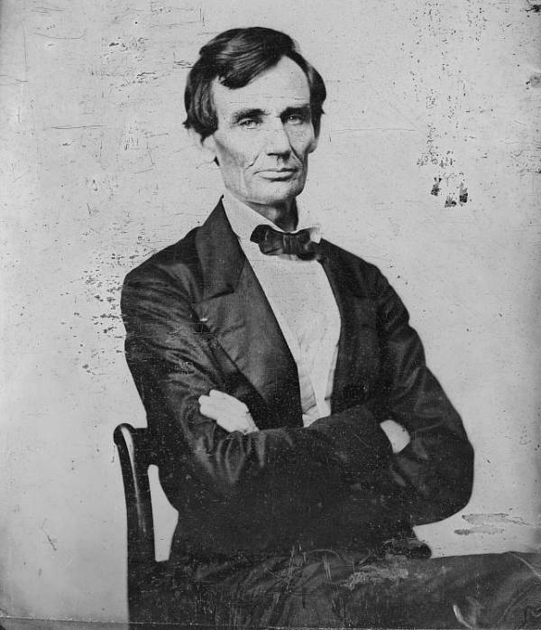
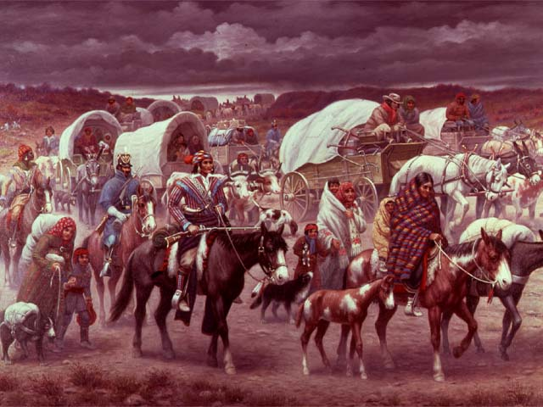
Impacts of Manifest Destiny
Native Americans:
They continually lost land and were pushed further and further west
Eventually, they were forced on reservations
Slavery:
Manifest destiny thrust the issue of slavery into the national spotlight
Debate over whether new land should be slave or free
Politics
Wilmot Proviso
Republican Party:
One of the platforms was to keep slavery from expanding

Slide 7
Thanks for watching!
Subscribe to my channel
Help spread the word
Questions? Comments? Ideas for videos?
Leave in comments
If you found the video helpful, please subscribe and spread the word….
Subscribe
Down here!

